Slide 1
Solving Problems
Larry OHeron
Lead Analyst
Laboratory for Laser Energetics

Slide 2
Summary
Prism is a framework for building loosely coupled, maintainable, and testable XAML applications in WPF, Windows 10 UWP, and Xamarin Forms.
I encountered various issues with using the PRISM framework.
Prism and Unity help design and build apps using loosely coupled components
evolve independently
easily and seamlessly integrated into the overall application
Design patterns: embody important architectural design principles
separation of concerns
loose coupling

Slide 3
Outline
Attempts to Install & Develop with PRISM
From Tight Coupling to Loose Coupling

Slide 4
System Requirements for PRISM
Prism’s various incarnations was designed to run on the Microsoft Windows 8 desktop, Windows 7, Vista, or Windows Server 2008 operating system.
Backwards compatibility among PRISM incarnations is not guaranteed. Upgrading may present challenges.

Slide 5
Typical Developer Advice
Before you can use the Prism Library, the following must be installed:
Microsoft .NET Framework 4.5 (installed with Visual Studio 2012) or Microsoft .NET Framework 4.51.
Microsoft Visual Studio 2012 or 2013 Professional, Premium, or Ultimate editions.
Before installing, consider uninstalling previous versions of PRISM and removing all references in any projects under update.

Slide 6
History of PRISM
Ver 4.1
Includes Silverlight
https://msdn.microsoft.com/en-us/library/Gg430869%28v=PandP.40%29.aspx
Ver 5.0
Managed by Microsoft. Now deprecated.
https://www.nuget.org/packages/Prism

Slide 7
History of PRISM
Ver 6.0
Microsoft turned PRISM over to the open source community to support the .NET community.
The Open Source community has no plans to create new versions of PRISM for Silverlight or Windows 8/8.1/WP8.1.

Slide 8
PRISM Installation
Visual Studio Package Manager Console. Installs package to the solution.
Configuring the NuGet Package Manager
Tools -> NuGet Package Manager -> Packet Manager Settings -> Package Sources -> Check the nuget.org source
Retrieve the current version of Unity 6.2.0 (Open Source)
Commands
Get-Package -ListAvailable Unity
Get-Package -ListAvailable Unity.Prism
Install-Package Prism.Core
Install-Package Prism.Unity

Slide 9
PRISM Installation
Retrieve version of Unity 4.1.0 (supports SilverLight)
PM> Install-Package Prism -Version 4.1.0
Retrieve version 5.0 (last version supported by Microsoft)
PM> Install-Package Prism

Slide 10
Package Manager Console Issues
Package Manager Console stopped responding to the keyboard
Windows PowerShell updated your execution policy successfully, but the setting is overridden by a policy defined at a more specific scope. Due to the override, your shell will retain its current effective execution policy of "RemoteSigned". Type "Get-ExecutionPolicy -List" to view your execution policy settings. For more information, please see "Get-Help Set-ExecutionPolicy."
NuGet Hotfix 2.8.7 (Download and run)
https://github.com/NuGet/Home/releases/download/2.8.7/NuGet.Tools.vsix

Slide 11
Package Manager Error
(Desktop) Installed PRISM Ver 6.0 successfully
(Laptop) PRISM Vers 6.0 did not install.
PM> Install-Package Prism.Unity
Attempting to resolve dependency 'Unity (≥ 4.0.1)'.
Attempting to resolve dependency 'CommonServiceLocator (≥ 1.3.0)'.
Attempting to resolve dependency 'Prism.Wpf (≥ 6.2.0)'.
Attempting to resolve dependency 'Prism.Core (≥ 6.2.0)'.
Attempting to resolve dependency 'Prism.Windows (≥ 6.0.2)'.
Attempting to resolve dependency 'System.Collections (≥ 4.0.10)'.
Install-Package : The 'System.Collections 4.0.10' package requires NuGet client version '3.0' or above, but the current NuGet version is '2.8.60610.756'.
At line:1 char:1
+ Install-Package Prism.Unity
+ ~~~~~~~~~~~~~~~~~~~~~~~~~~~
+ CategoryInfo : NotSpecified: (:) [Install-Package], NuGetVersionNotSatisfiedException
PM> Install-Package NuGet.VisualStudio

Slide 12
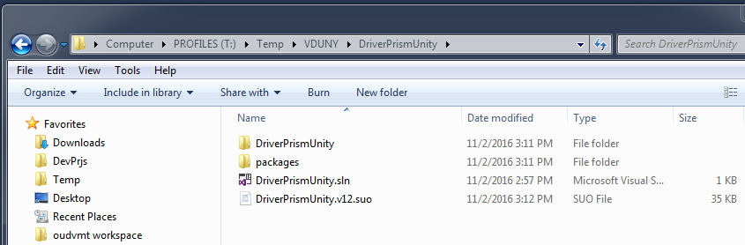
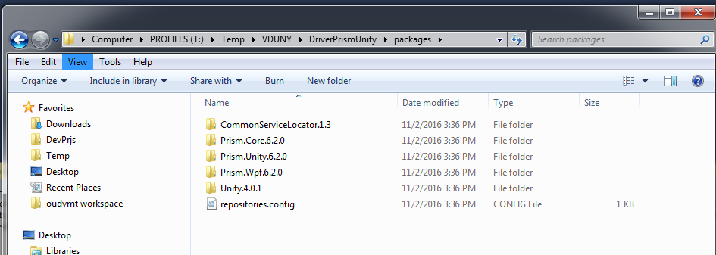
PRISM Installation - Solution ( after install )

Slide 13
Tight Coupling vs Loose Coupling
Tight coupling: a group of classes are highly dependent on one another. Arises when a class assumes too many responsibilities, or when one concern is spread over many classes .
Loose coupling promotes single-responsibility and separation of concerns.
A loosely-coupled class is consumed/tested independently of concrete classes.
How often do changes in class A force changes in class B?
Real-world example: Think of, for some medical reason, needing to change a patch of your skin. Painful, hurting, very difficult. Now think of changing a shirt. Easy, painless, quick.

Slide 14
Tight Coupling Example
class CustomerRepository
{
private readonly Database database;
public CustomerRepository(Database database) { this.database = database; }
public void Add(string CustomerName) { database.AddRow("Customer", CustomerName); }
}
class Database {
public void AddRow(string Table, string Value) { }
}

Slide 15
Solution 1: Tightly Coupled Weather Client - Server

Slide 16
Coupling Advantages and Disdvantages
Code complexity: “just another layer of indirection” … “Would you solder a lightbulb directly to the wires in a wall outlet?”
Cannot compile Class A without Class B if A depends on B.
Difficult to test Class A without instantiating Class B, e.g. a datasource.
Limits functionality to a single way of implementing.

Slide 17
Loose Coupling Example
class CustomerRepository {
private readonly IDatabase database;
public CustomerRepository(IDatabase database) {
this.database = database;
}
public void Add(string CustomerName) {
database.AddRow("Customer", CustomerName); }
}
interface IDatabase { void AddRow(string Table, string Value); }
class Database : IDatabase {
public void AddRow(string Table, string Value) { }
}

Slide 18
Dependency Injection
Define dependencies as interfaces and pass in vía a constructor
Interfaces are a powerful tool to use for decoupling.
Classes communicate through interfaces, not other concrete classes
Any class on the other end of that communication simply implements the interface.

Slide 19
Dependency Injection: Rationale
Design Pattern that demonstrates how to create loosely coupled classes.
The idea is to “inject” a dependency from outside the class.
Class A does not create an instance of Class B. … Someone provides an instance of Class B to Class A.
Constructor Injection: e.g. public Foo(IService service);
Setter Injection: e.g. public IService Service {get; set;}
Method Injection: e.g. public void Run(IService service) { } ;

Slide 20
Dependency Injection
Constructor Injection:
Most common. Injected component available thruout class.
Setter Injection:
Class optional dependencies. Need to null check thruout class.
Method Injection:
For use in a single method. Usually used for edge cases.

Slide 21
Solution 2: Polymorphism

Slide 22
Event Coupling
Let the container notify the client that something happened.
Let the client decide what to do about it.
Button enabling/disabling
Status updates
Report a new condition …. or not.

Slide 23
Solution 3: Removing Direct Calls

Slide 24
Interface-based Programming
Separates the public interface from the private implementation.
What must a client know about a class in order to obtain benefits from usage?
Once a property or method signature is in a class public interface, you cannot change or remove it.
Must properly design at the beginning of a project
Must use self-discipline at the class evolves.

Slide 25
Solution 4: Extending Functionality

Slide 26
Dynamic Building of an Application
Encapsulate UI components and activity behaviors into modules.
Swap modules in and out of activities.
Update a client by providing the new module, rather than redeploying a new app.

Slide 27
Solution 5: Removing all References

Slide 28
Solution 6: Loose Coupling of the View State

Slide 29
Nonrandom Random Number Generator
How random is the random number generator?
Pseudo-random numbers are chosen with equal probability from a finite set of numbers.
If the same seed is used for separate Random objects, they will generate the same series of random numbers. Useful for testing.
The clock has finite resolution. Using the parameterless constructor to create different Random objects in close succession creates random number generators that produce identical sequences of random numbers.

Slide 30
Wrap-up
Questions?
Comments?

Slide 31
Links

